Slide 1


OSLO Air and Water:
Workshop 4
Welcome!
Thursday April 27th 2021
Virtual working group – Microsoft Teams
Starting at 13:05 CEST

Slide 2

Purpose of today
Recap TW3
Changes to the Core - Air - Water Models
Feedback on definition & resolution
Alignment NGSI-ld & OSLO models

Slide 3
Agenda
Topic | Time (mins) | Timestamps
Start TW4 | 5 mins | 13:05
Introduction & Who’s in the room | 5 mins | 13:10
TW3 Recap | 10 mins | 13:20
Changes to the models since TW3 | 40 mins | 14:00
Break | 10 mins | 14:10
Definitions | 40 mins | 14:50
Online Publication | 15 min | 15:05
NGSI-LD Alignment | 10 min | 15:15
Next Steps | 10 min | 15:25

Slide 4



Practicalities
Audience sound is muted by default
Use your hand if you want to say something. Interaction is encouraged!
Video camera encouraged
Questions, comments and suggestions can be communicated via the chat function. Interaction is encouraged!
yes/no questions can be answered via chat:
Agree = +1
Do not agree = - 1
Indifferent = 0

Slide 5
Welcome and introduction

Slide 6
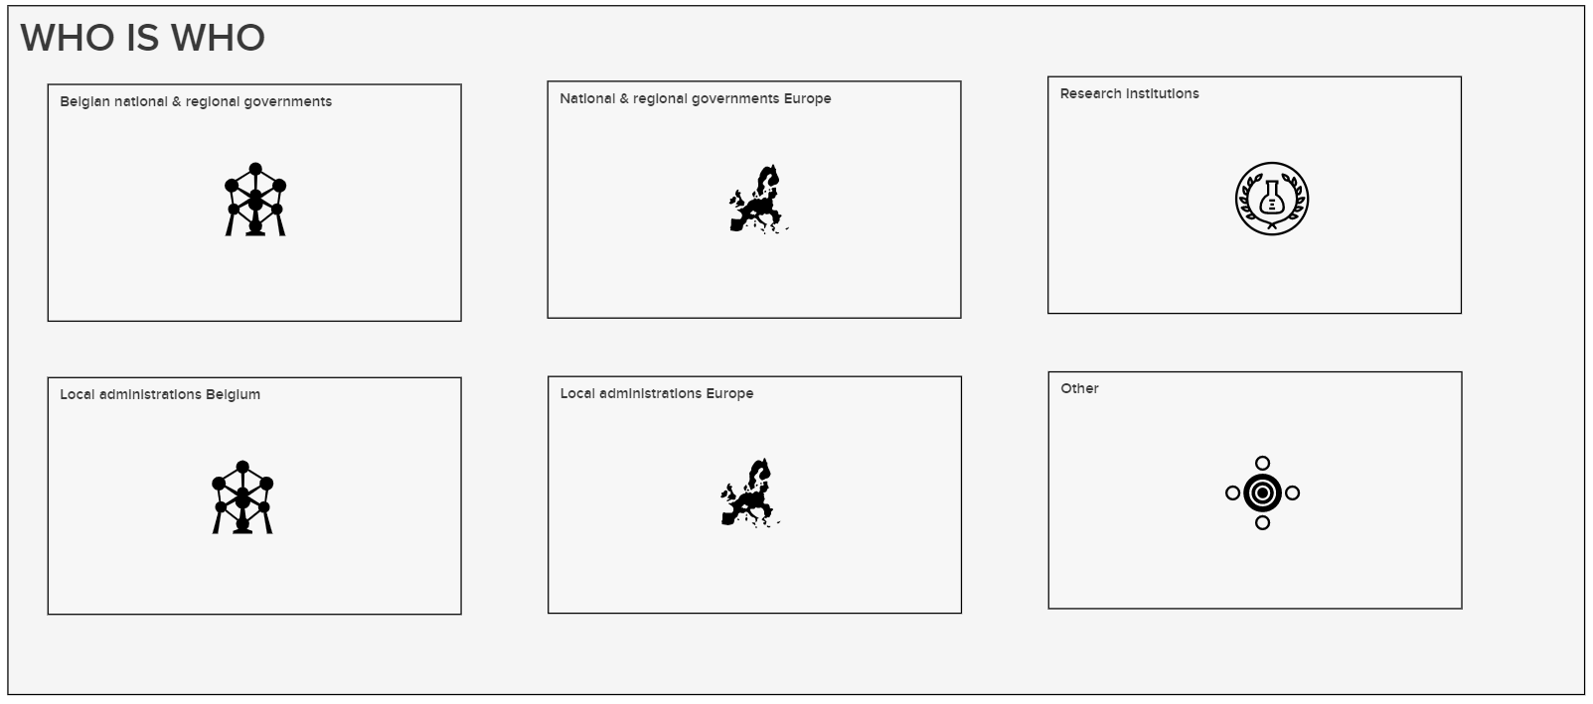
Who’s in the room?
5’
https://app.mural.co/t/beadvtc7549/m/beadvtc7549/1619423761877/7c32c37861773783943325b084c0ed1bcb46975e

Slide 7
TW3 Recap

Slide 8


Resolution of the Github issues
1
ObservedProperties
2
SampledFeature
3
Sampling Feature
4
Observation subtypes
5
ObservationCollections
All issues were discussed and feedback was incorporated in the new models

Slide 9
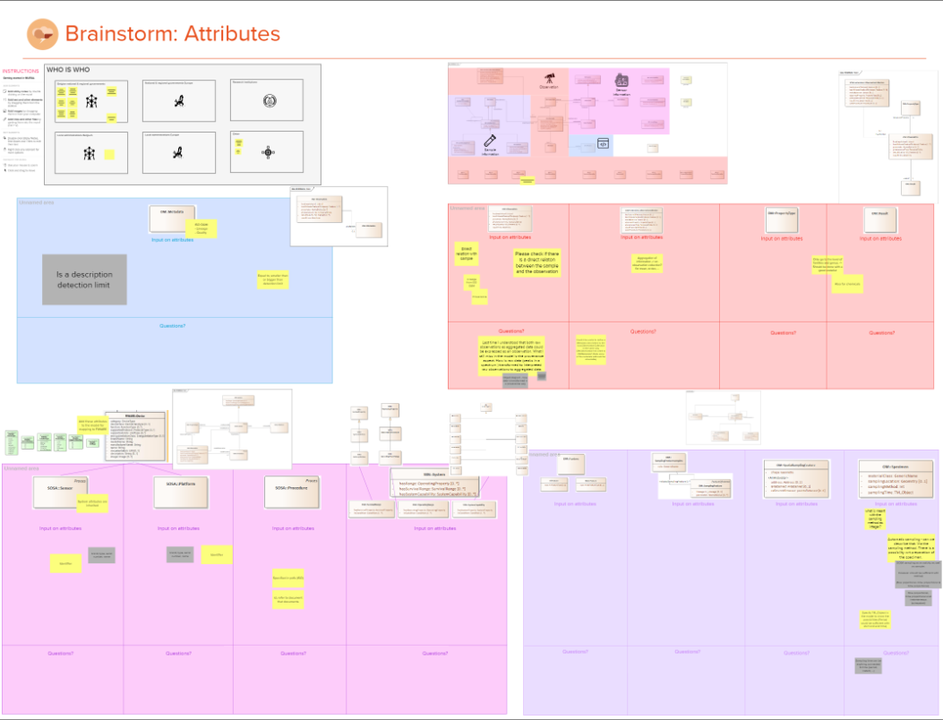
And we received additional input
Additional input received has been translated to concrete action points:
Metadata
Lineage & Quality
Link with ObsevationCollection
Device - Sensor - Platform attributes
Procedure attributes
Specimen
Automatic sampling
Preparation of sample
ObservationCollection
qb:Slice
Aggregation of information (mean...)
Observation
Direct relation w/ sample
Lineage
Provenance

Slide 10
Changes to the model since TW3
Core - Air - Water

Slide 11
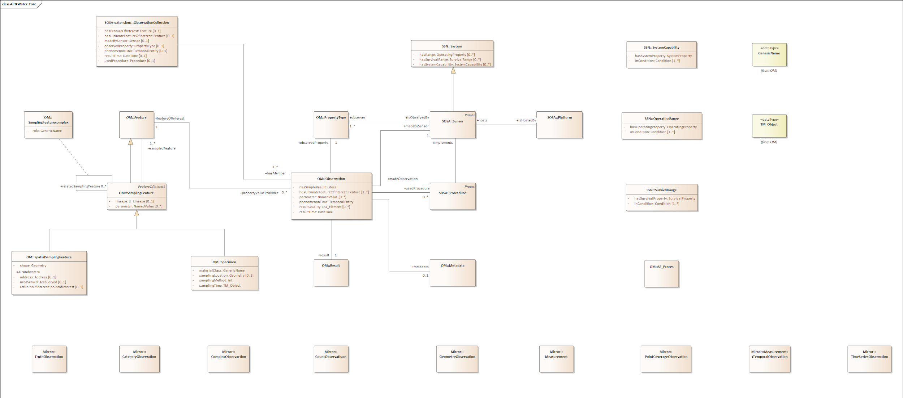




Core Model (TW3)
Observation
Sensor
Sampling
Metadata

Slide 12
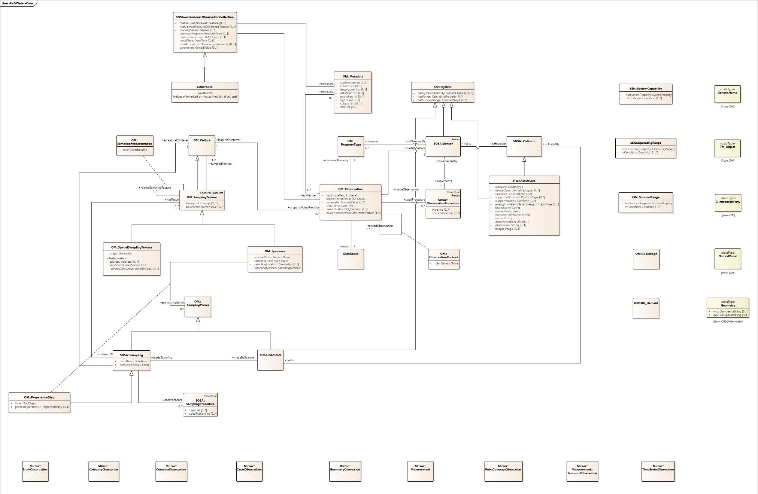
Core Model (Revised)
Metadata

Slide 13
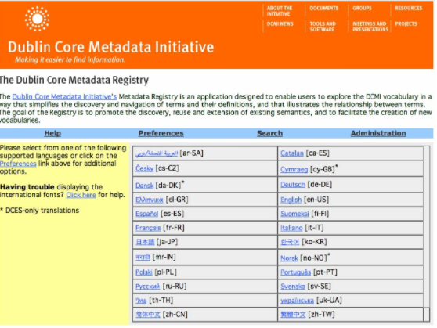
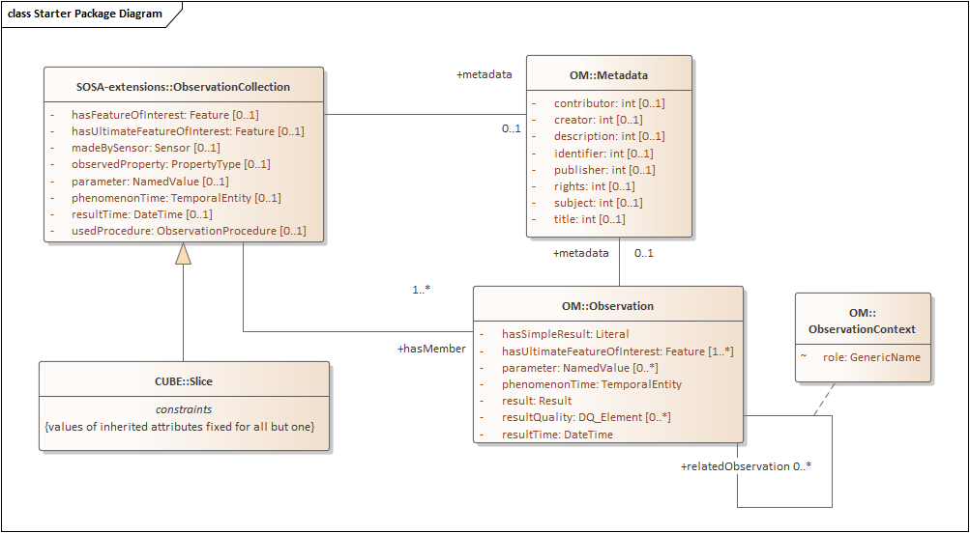
Core Model (Revised)
Link between Metadata & ObservationCollection
Addition of qb:Slice
Attributes Metadata based on Dublin Core
Observation Context Can be used to contextually link observations to one another (for example provenance)
resultQuality
1.
3.
4.
2.

Slide 14
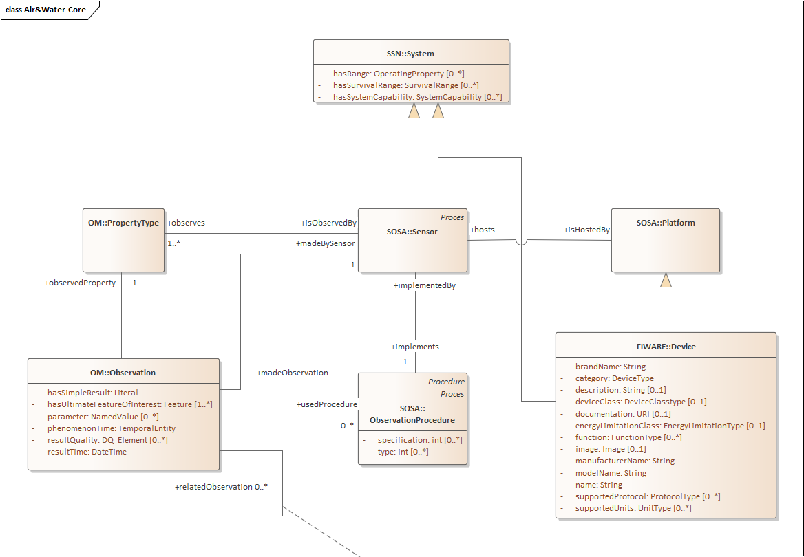
Core Model (Revised)
Attributes ObservationProcedure Addition of type & specification
Addition of Attributes for Sensor & Platform We opted for including FIWARE::Device in the model to avoid having to specify the attributes multiple times
2.
1.

Slide 15
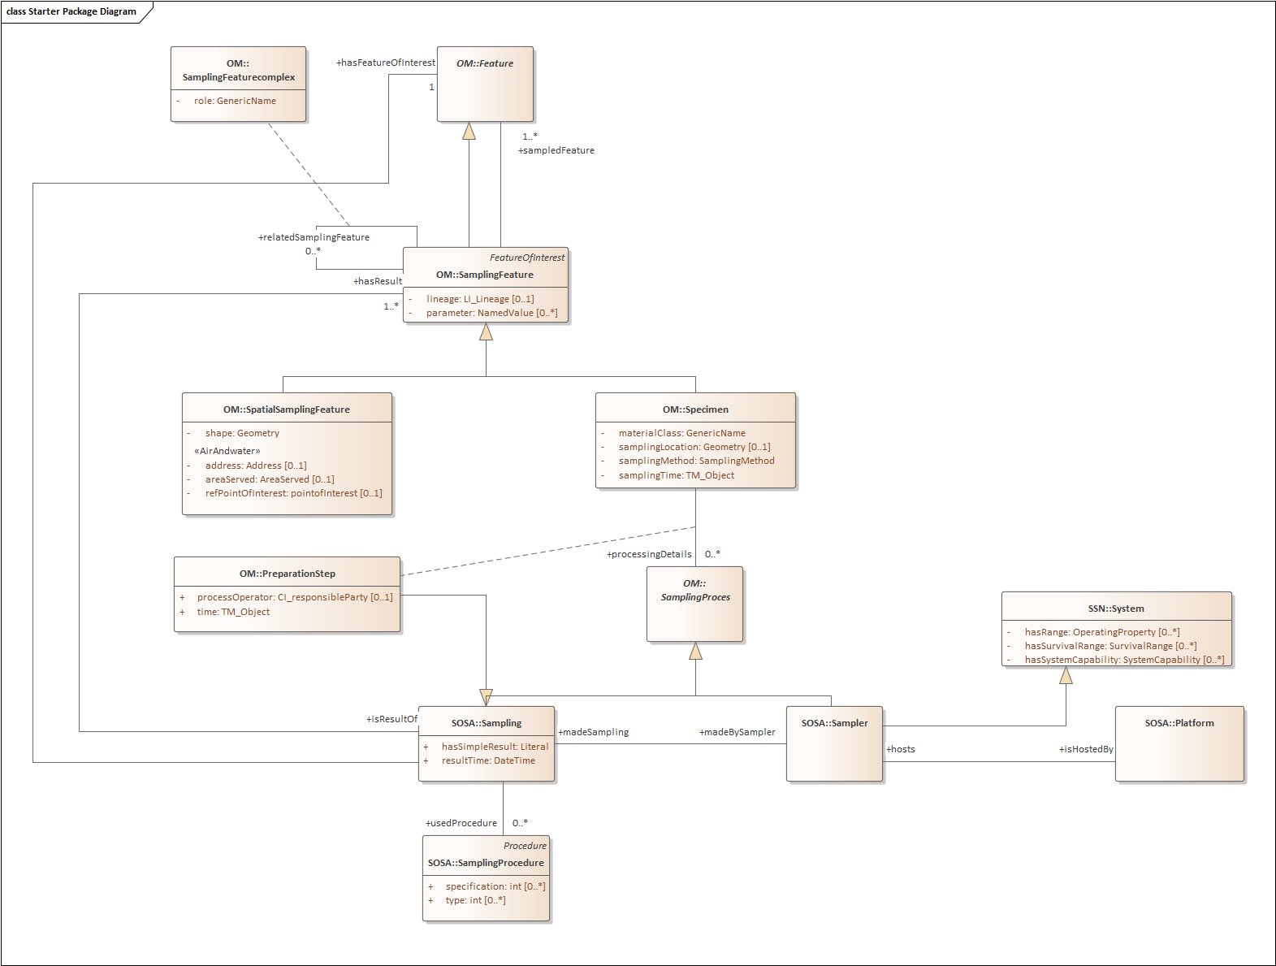
Core Model (Revised)
Addition of Sampling process as well as the Sampling activity & Sampler. Sampling is used to describe the activity of sampling and the procedure used. Individual sampling steps can also be described.
Secondly, additional inform on the sampler was also added to the model. A sampler can also be seen as a system and is hosted on a platform.
Addition of lineage
Best of both worlds: OM & SOSA

Slide 16




Air Model & Water models
No major change to the Air & Water models, but mainly a simplification of the models
No need to redefine what’s been defined in Core model
All building blocks from the core model can be reused in Air & Water models

Slide 17
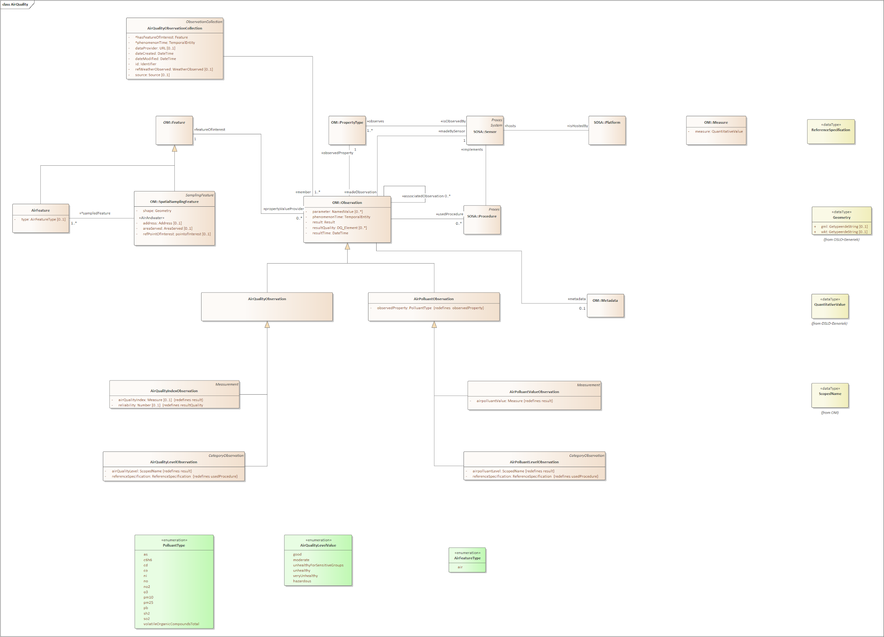
Air Model (TW3)
Observation
Sensor
Sampling
Metadata

Slide 18
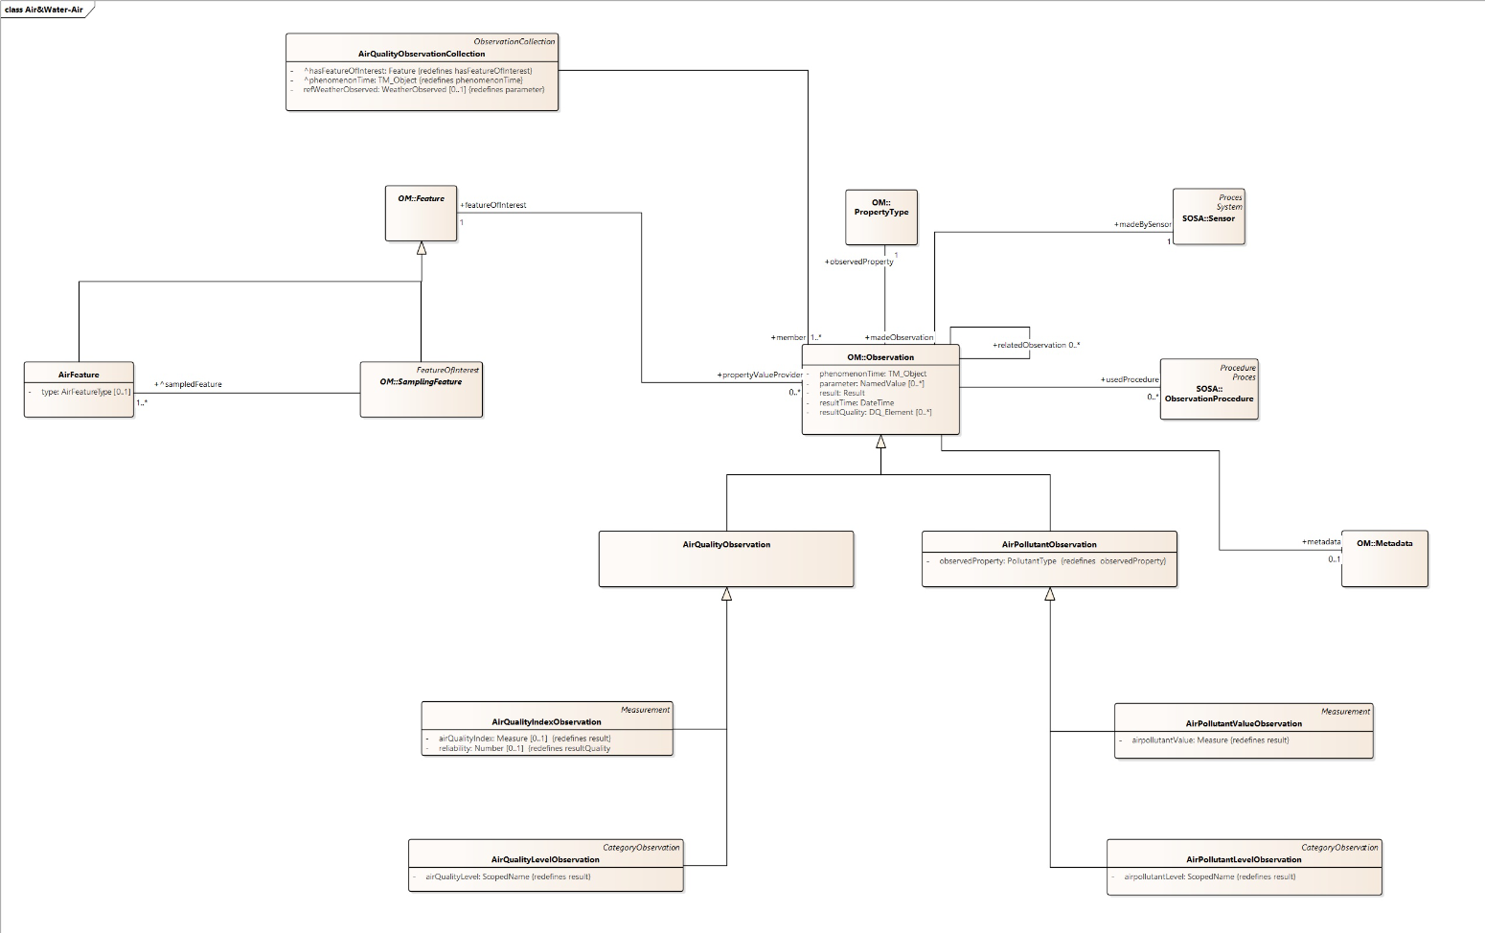
Air Model (revised)
Observation
Sensor
Sampling
Metadata

Slide 19
Air Model (revised)

Slide 20
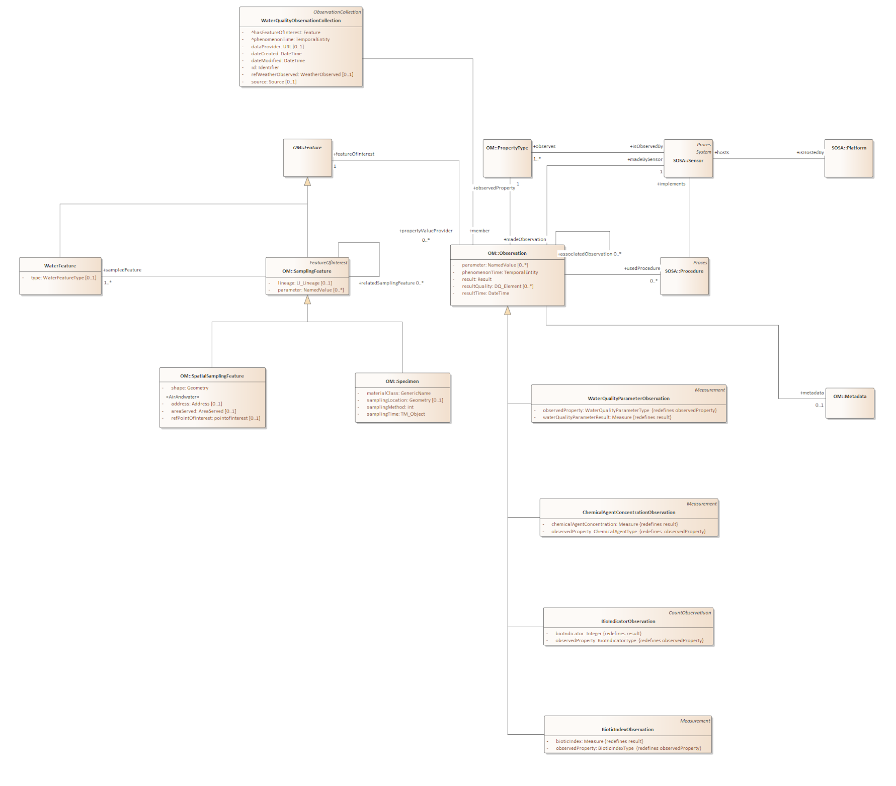
Water Model (TW3)
Observation
Sensor
Sampling
Metadata

Slide 21
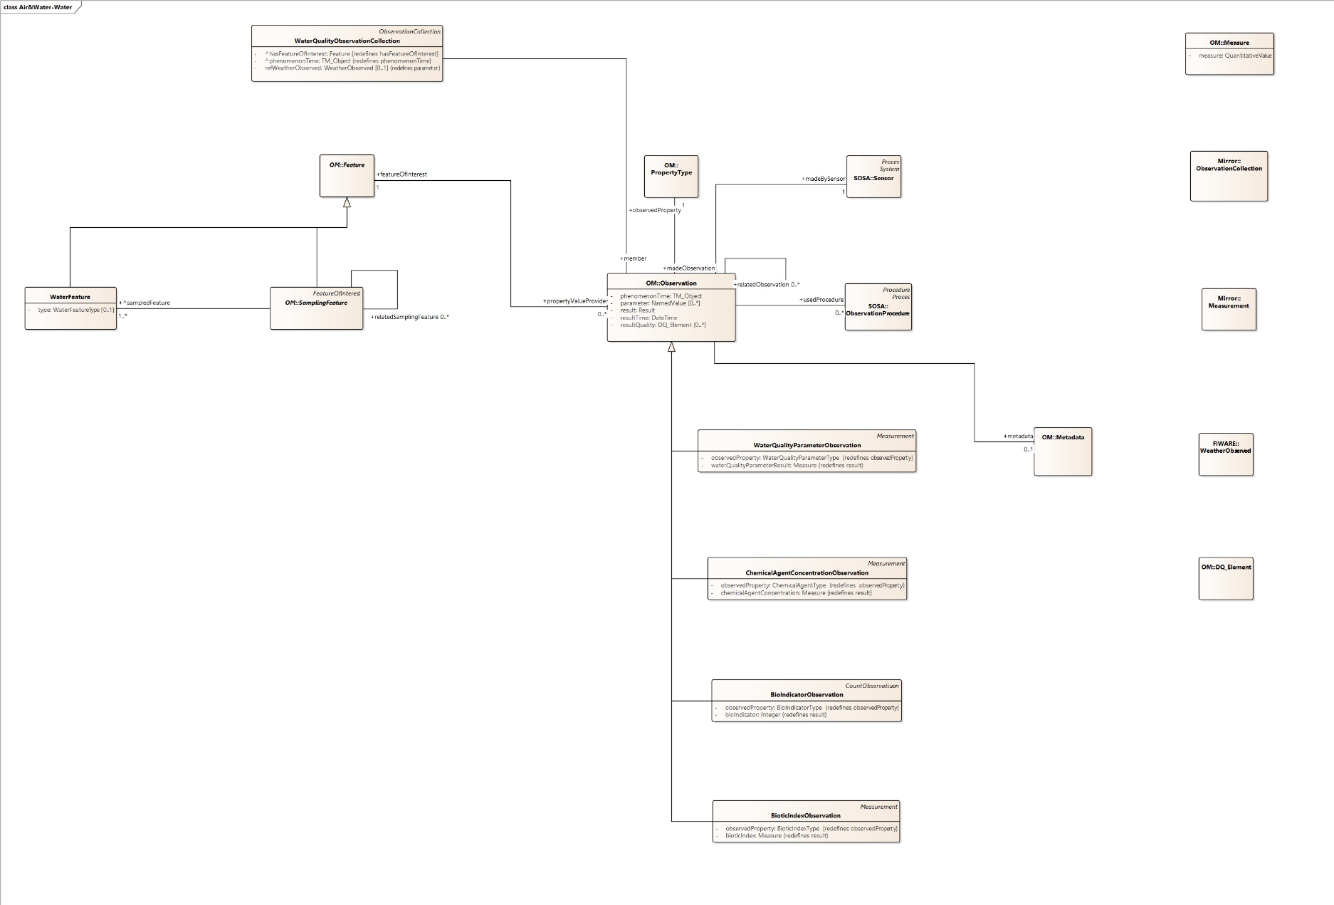
Water Model (TW3)
Observation
Sensor
Sampling
Metadata

Slide 22
Water Model (TW3)

Slide 23

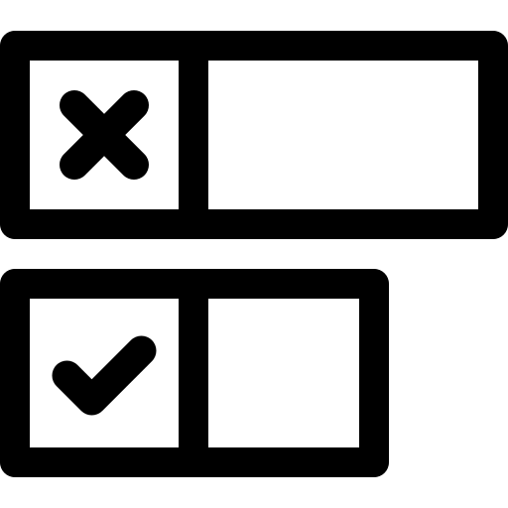
Checkpoint: Models
Are the models ok (+1) or not (-1)* ?
*If -1, please elaborate what is still missing or incorrect.

Slide 24
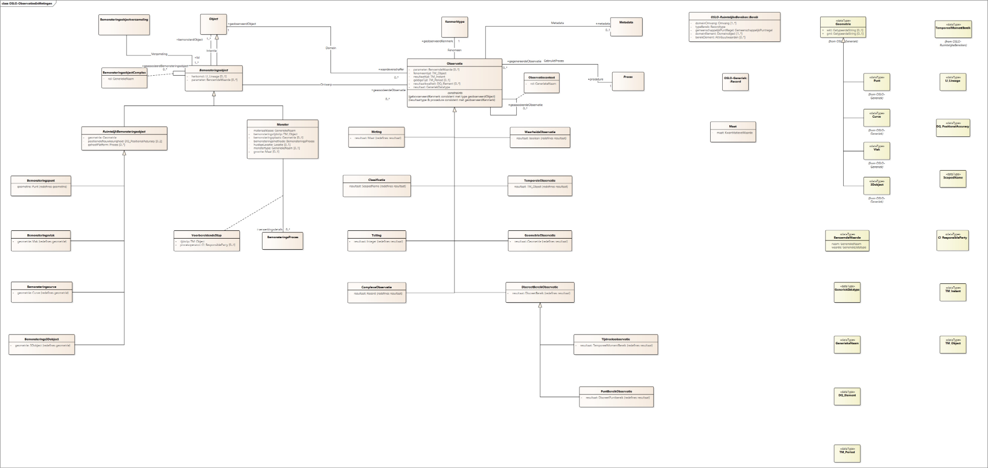
ISO O&M (NL) to be translated to English for reference

Slide 25
The layers of OSLO Air & Water: Application profiles
Air
Water
Core
ISO Observation & Measurement

Slide 26
A small break...

Slide 27
Welcome back!

Slide 28
Definitions

Slide 29
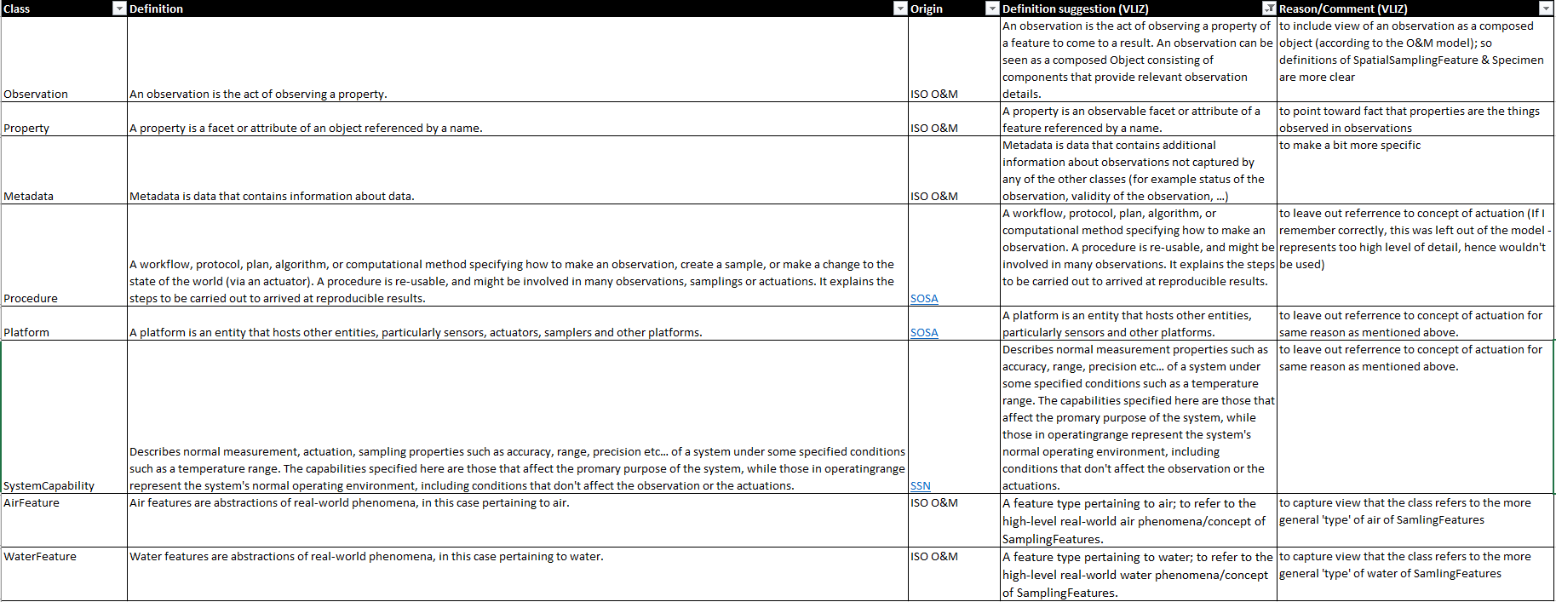
Feedback received via Github

Slide 30
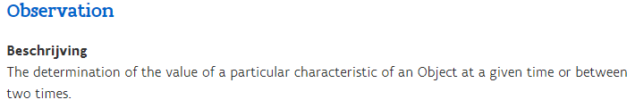
Feedback received via Github
Observation “An observation is the act of observing a property” - ISO O&M Feedback “An observation is the act of observing a property of a feature to come to a result. An observation can be seen as a composed object consisting of components that provide relevant observation details.”
Proposal
Update definition and include the feedback as additional information in the usageNotes as illustrated below:
Definition
The determination of the value of a particular characteristic of an object at a given time or between two times.
Usage
An observation is the act of observing a property of a feature to come to a result. An observation can be seen as a composed object consisting of components that provide relevant observation details
Do you agree (+1) or disagree (-1)?

Slide 31
Feedback received via Github
Property A property is a facet or attribute of an object referenced by a name. - ISO O&M Feedback A property is an observable facet or attribute of an object referenced by a name.
Proposal
Maintain ISO definition.
Do you agree (+1) or disagree (-1)?

Slide 32
Feedback received via Github
Metadata Metadata is data that contains information about data. - ISO Feedback Metadata is data that contains additional information about observations not captured by any of the other classes (for example status of the observation, validity of the observation…)
Proposal
Maintain ISO definition of Metadata and include usage note with additional information.
Do you agree (+1) or disagree (-1)?

Slide 33
Feedback received via Github
Procedure A workflow, protocol, plan, algorithm or computational method specifying how to make an observation, create a sample, or make a change to the state of the world (an actuation). A procedure is reusable, and might be involved in many observations, samplings or actuations. It explains the steps to be carried out to arrive at reproducible results.
Platform A platform is an entity that hosts other entities, particularly sensors, actuators, samplers and other platforms. System capability
Describes normal measurement, actuation, sampling properties such as accuracy, range, […] - SSN
Proposal
Leave out reference to concept of actuation as it is not included in the model
Do you agree (+1) or disagree (-1)?

Slide 34
Feedback received via Github
AirFeature
Air Features are abstractions of real world phenomena, in this case pertaining to air.
WaterFeature
Water Features are abstractions of real world phenomena, in this case pertaining to water.
Feedback
A feature type pertaining to air/water, to refer to the high-level real-world air/water phenomena/concept of SamplingFeatures.
Proposal
Maintain ISO O&M definition
Do you agree (+1) or disagree (-1)?

Slide 35
Checkpoint: Definitions
Are the definitions ok (+1) or not (-1)* ?
*If -1, please elaborate what is still missing or incorrect.

Slide 36
Online Publication

Slide 37
Next step in the process: Public review
2020
2021
December
January
February
March
April
May
June
July
August
September
October
Implementation of draft specifications
Start of public review
Business workshop
Thematic workshops
Final webinar
Final validation of the standard scheduled by Q4 (after Final webinar)

Slide 38
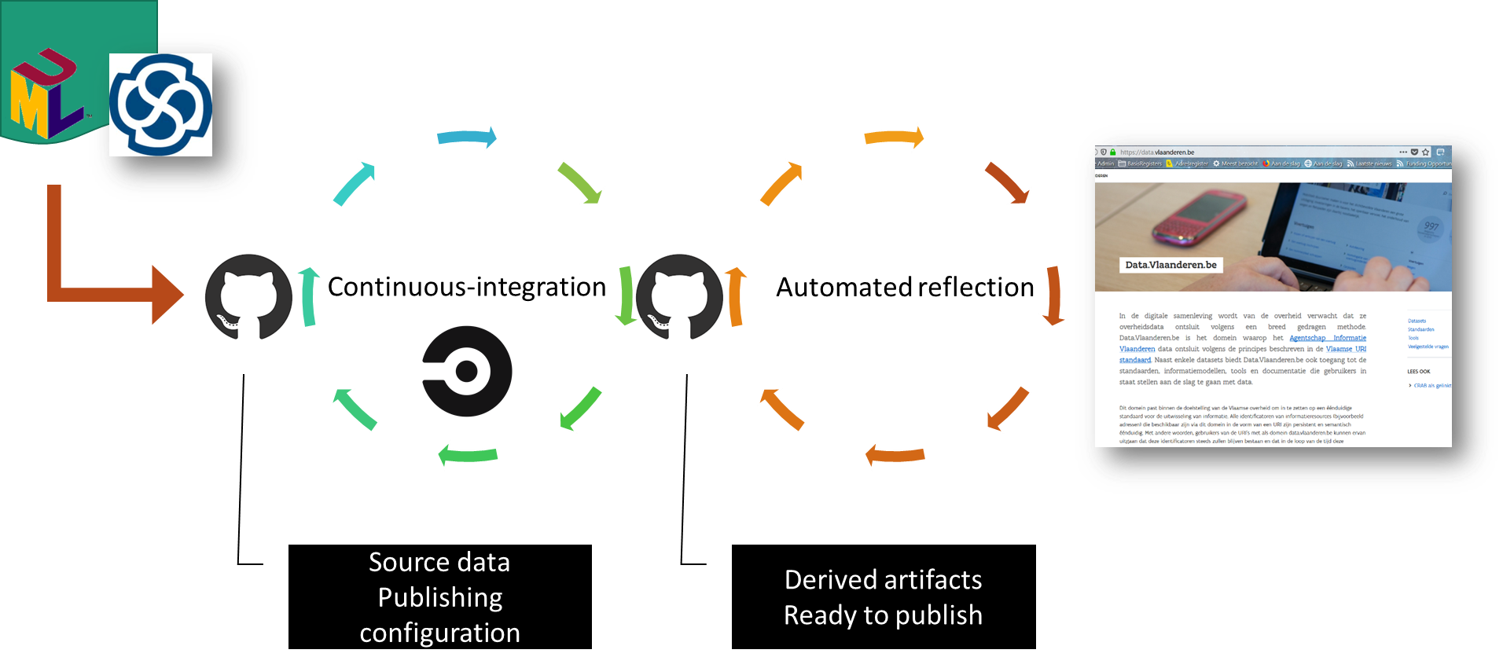
Workflow Online publication

Slide 39
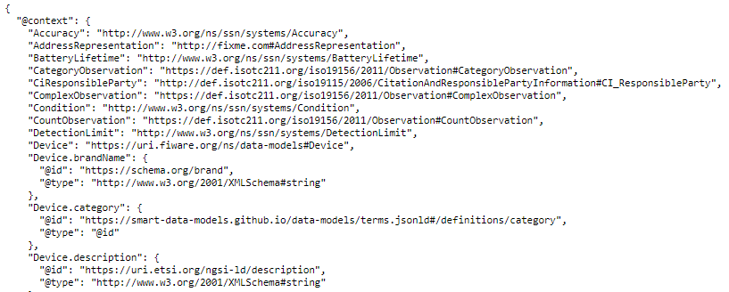
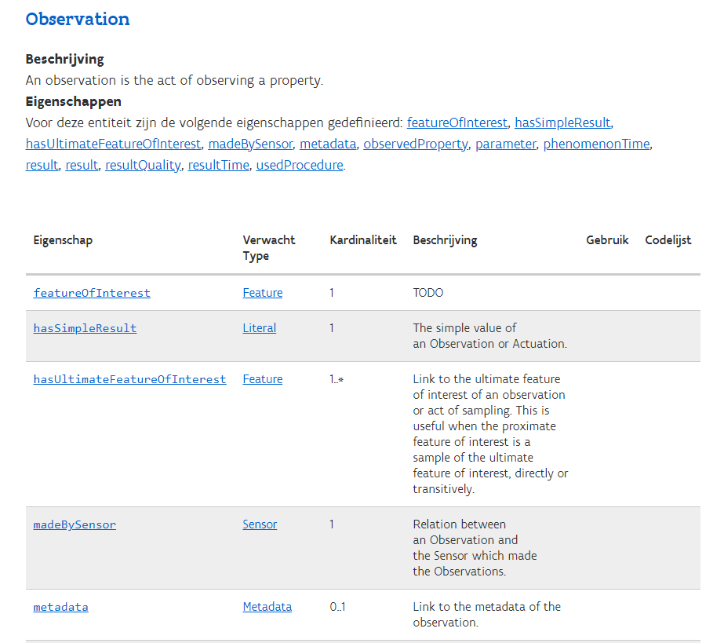

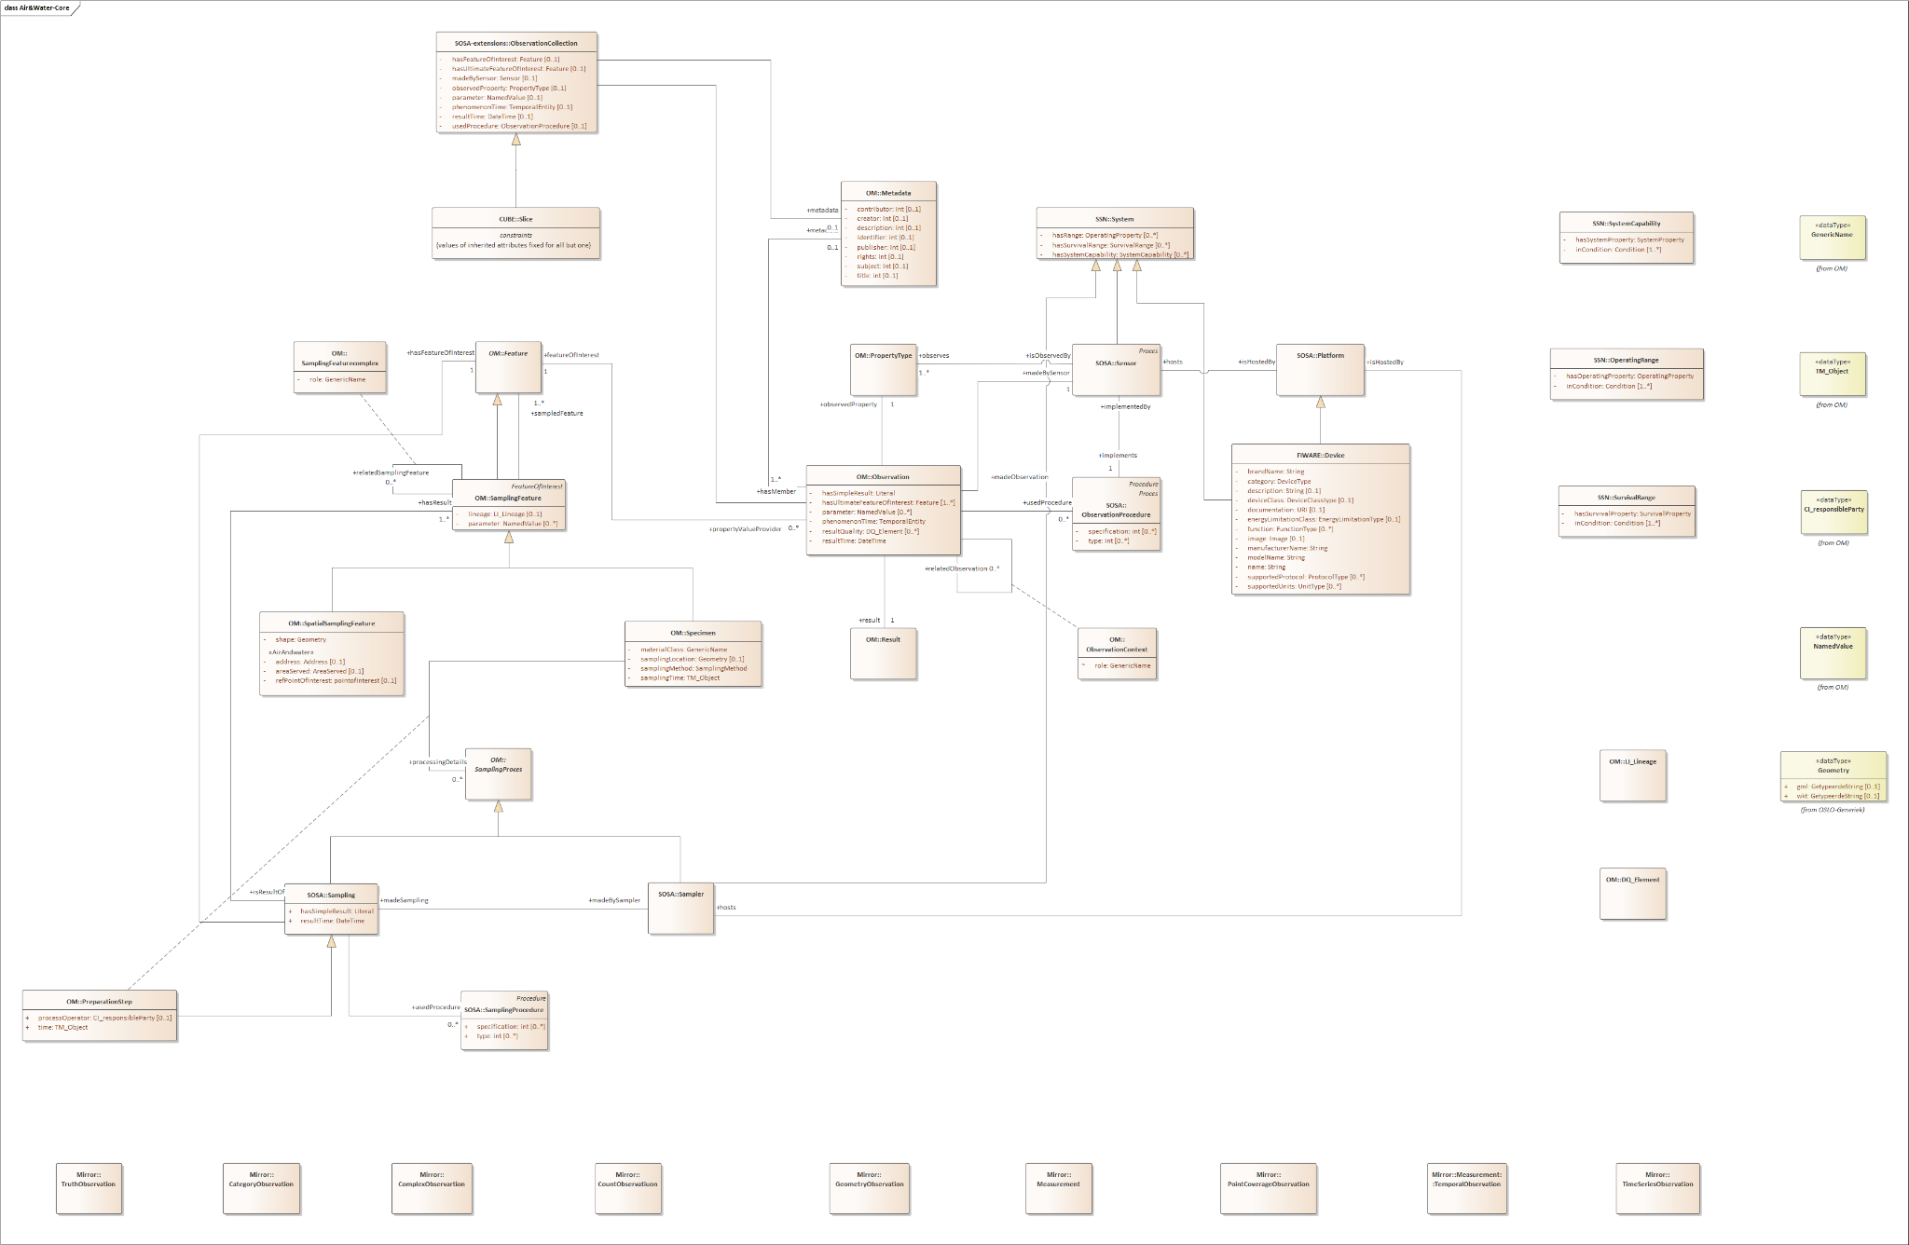
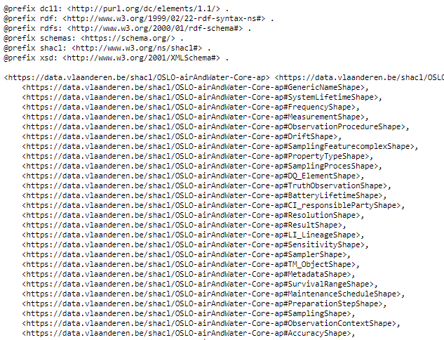

Workflow Online publication

Slide 40
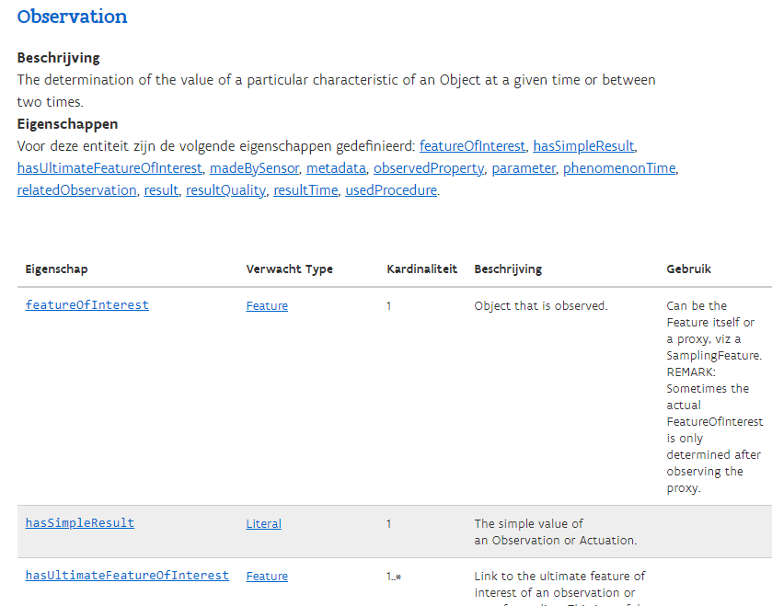
Online Publication of the draft models
https://test.data.vlaanderen.be/doc/applicatieprofiel/AirAndWater/Core/ontwerpstandaard/2021-04-16
https://test.data.vlaanderen.be/doc/applicatieprofiel/AirAndWater/Air/ontwerpstandaard/2021-04-16
https://test.data.vlaanderen.be/doc/applicatieprofiel/AirAndWater/Water/ontwerpstandaard/2021-04-16
To do: Migrate models to purl.eu domain (English templates)
To do: Review the specs and if needed provide your feedback via Github by adding an issue to the Github repository

Slide 41
NGSI-LD Alignment

Slide 42
Alignment NGSI-LD & UML - JSON-LD
{
"@context": {
"ngsi-ld": "https://uri.etsi.org/ngsi-ld/",
"id": "@id",
"type": "@type",
"value": "https://uri.etsi.org/ngsi-ld/hasValue",
"object": {
"@id": "https://uri.etsi.org/ngsi-ld/hasObject",
"@type":"@id"
},
"Property": "https://uri.etsi.org/ngsi-ld/Property",
"Relationship": "https://uri.etsi.org/ngsi-ld/Relationship",
"DateTime": "https://uri.etsi.org/ngsi-ld/DateTime",
"Date": "https://uri.etsi.org/ngsi-ld/Date",
"Time": "https://uri.etsi.org/ngsi-ld/Time",
"createdAt": {
"@id": "https://uri.etsi.org/ngsi-ld/createdAt",
"@type": "DateTime"
},
"modifiedAt": {
"@id": "https://uri.etsi.org/ngsi-ld/modifiedAt",
"@type": "DateTime"
},
"observedAt": {
"@id": "https://uri.etsi.org/ngsi-ld/observedAt",
"@type": "DateTime"
},
[...]
}
}
Many participants work with FIWARE data brokers that exchange information in NGSI-LD format. Main question that rose up was how to be able to communicate with these data brokers
Similar to JSON-LD, NGSI-LD uses a context in order to give more information on the data that is being exchanged. It will always use the NGSI Core Context; but other context files can be added as well.
Core context https://uri.etsi.org/ngsi-ld/v1/ngsi-ld-core-context.jsonld

Slide 43
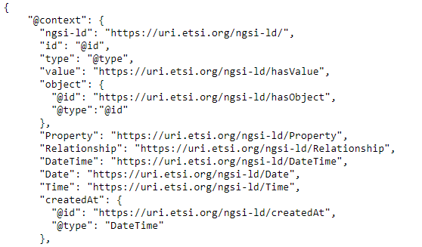
Alignment NGSI-LD & UML - JSON-LD
{
"id": "urn:ngsi-ld:AirQualityObserved:RZ:Obsv4567",
"type": "AirQualityObserved",
"dateObserved": {
"type": "Property",
"value": {
"@type": "DateTime",
"@value": "2018-08-07T12:00:00Z"
}
},
"NO2": {
"type": "Property",
"value": 22,
"unitCode": "GP"
},
"refPointOfInterest": {
"type": "Relationship",
"object": "urn:ngsi-ld:PointOfInterest:RZ:MainSquare"
},
"@context": [
"https://schema.lab.fiware.org/ld/context",
"https://uri.etsi.org/ngsi-ld/v1/ngsi-ld-core-context.jsonld"
]
}
Currently FIWARE specifies its own context file on top of the NGSI-LD core context. See example from FIWARE AirQualityObserved
NGSI Core Context

Slide 44
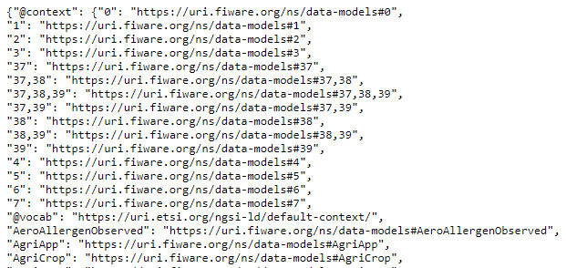
Alignment NGSI-LD & UML - JSON-LD
{
"id": "urn:ngsi-ld:AirQualityObserved:RZ:Obsv4567",
"type": "AirQualityObserved",
"dateObserved": {
"type": "Property",
"value": {
"@type": "DateTime",
"@value": "2018-08-07T12:00:00Z"
}
},
"NO2": {
"type": "Property",
"value": 22,
"unitCode": "GP"
},
"refPointOfInterest": {
"type": "Relationship",
"object": "urn:ngsi-ld:PointOfInterest:RZ:MainSquare"
},
"@context": [
"https://schema.lab.fiware.org/ld/context",
"https://uri.etsi.org/ngsi-ld/v1/ngsi-ld-core-context.jsonld"
]
}
Currently FIWARE specifies its own context file on top of the NGSI-LD core context. See example from FIWARE AirQualityObserved
Similar approach should be used for the Air & Water Quality models

Slide 45
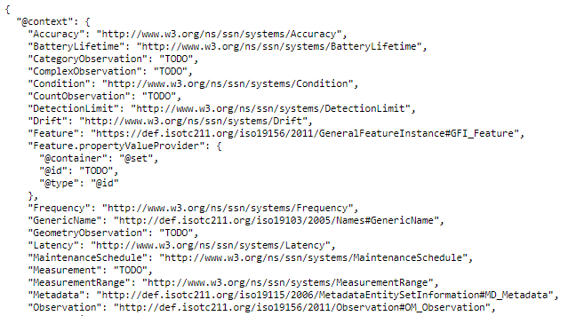
Alignment NGSI-LD & UML - JSON-LD
{
"@context": [
"https://test.data.vlaanderen.be/doc/applicatieprofiel/AirAndWater/Core/ontwerpstandaard/2021-04-16/context/OSLO-airAndWater-Core-ap.jsonld",
"https://uri.etsi.org/ngsi-ld/v1/ngsi-ld-core-context.jsonld"
]
}

Slide 46
Next steps

Slide 47


Next Steps
Migrate models to purl.eu domain and include the links to the draft models to the meeting minutes of this workshop. We will try to send these by week of May 11th
Public Review: Review specs & provide input on Github page. Deadline of public review will be dependent on planned POC. ETA expected by end of Aug - Sept.
After public review a public webinar will be organised to summarize this project where we’ll also give an account of all the issues logged & resolved during public review

Slide 48

Feedback & collaboration
Feedback can be provided by email to the following people:
kevin.haleydt@vlaanderen.be
Feedback/input can be provided through GitHub: https://github.com/Informatievlaanderen/OSLOthema-airAndWater

Slide 49
Issues logged on Github
https://github.com/Informatievlaanderen/OSLOthema-airAndWater

Slide 50

Are there any questions left?

Slide 51
Thanks!

